Slide 1


Vikings and Saxons
A Python OOP exercise

Slide 2

Our goal
- Define classes for Soldiers, Vikings, Saxons, and War
- Use Object-Oriented Programming principles (classes, inheritance, methods)

Slide 3

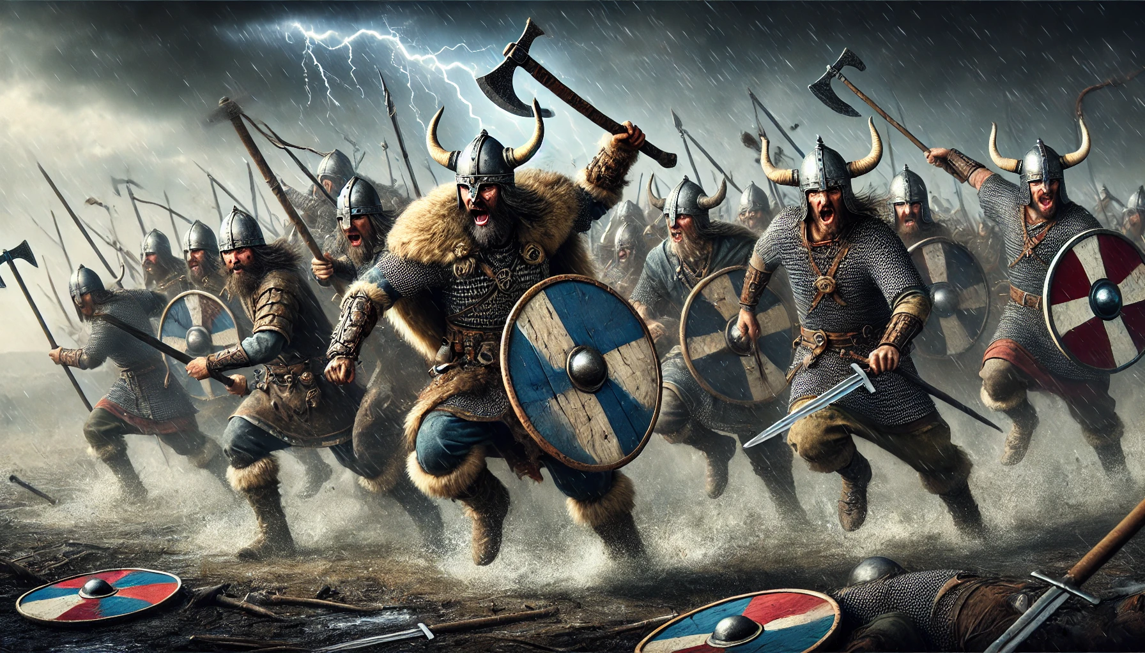
Making a Soldier
(can be Viking or Saxon)
Soldier
Attributes/ What makes a soldier:
health
strength
Methods/ What does a soldier do:
attack
receive
Damage

Slide 4
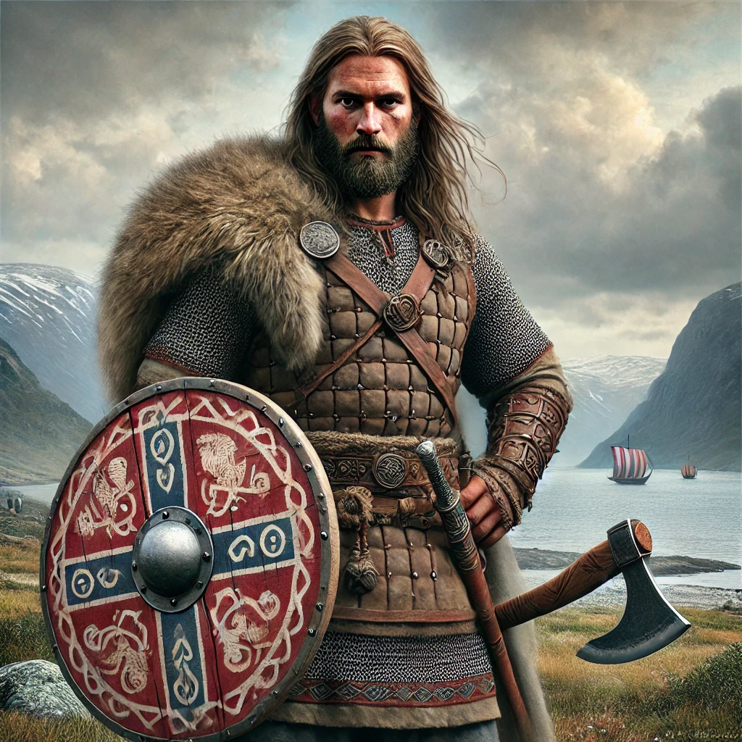
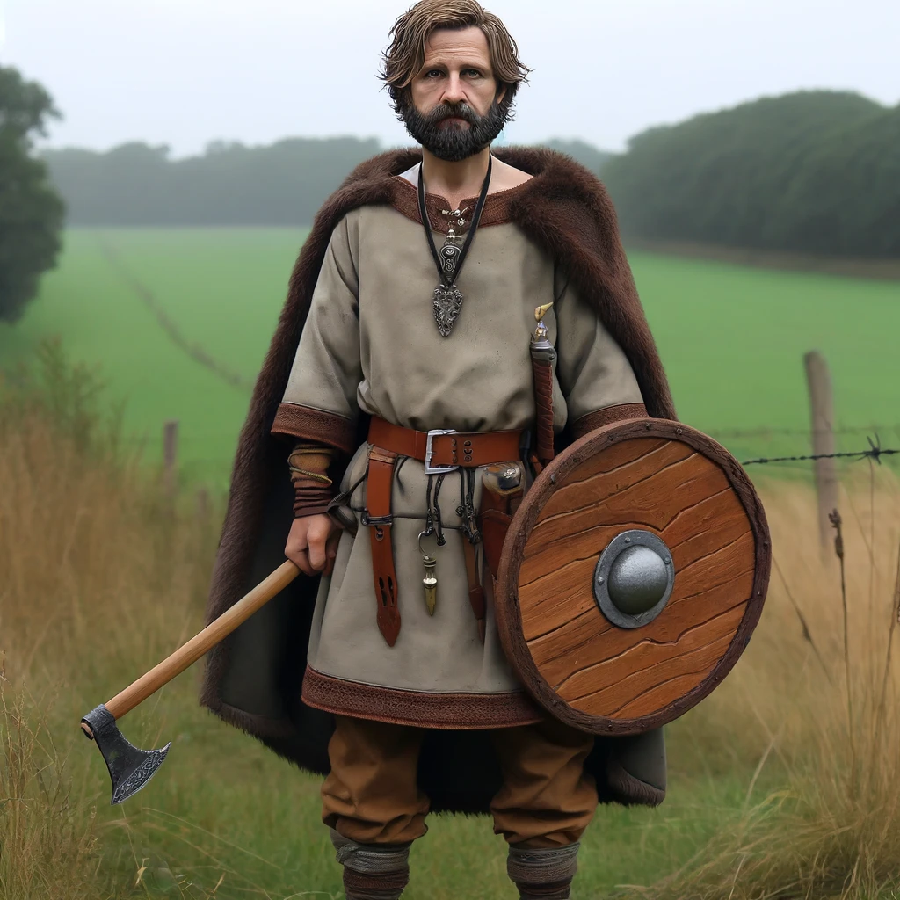
Making a Viking
(A Viking is a Soldier...
But a fancy one)
Making a Saxon
(A Saxon is a Soldier... an anonymous one, with less motivation)
Viking
Saxon
Inherits Soldier
Inherits Soldier
Attributes/ What makes a viking
Attributes/ What makes a saxon
name
health
strength
battleCry
health
strength
Methods/ What does a viking do:
Methods/ What does a saxon do:
attack
receive
Damage
receive
Damage
attack

Slide 5
An now… it’s war!!
war.methods()
Viking and Saxon Armies
Viking and Saxon Attacks
Who won
Attributes/ What makes a viking
Attributes/ What makes a viking
Attributes/ What makes a viking
vikingAttack
saxonAttack
Methods/ What does a saxon do:
Methods/ What does a saxon do:
Methods/ What does a saxon do:
addViking
- select random attacker and defender from both armies
- use receiveDamage() on the defender
- remove dead soldiers from the army
showStatus
addSaxon

Slide 6
Our challenges
1. super() in Viking Class
Initially unclear how super() works to inherit properties (health and strength) from the Soldier class.
Improvement: To access inheritance, we use super() to call the parent class's methods and properties. After review, it became clear that super() avoids code repetition and ensures Vikings inherit Soldier attributes while adding unique methods like battleCry().
2. random.choice in War Class
Challenge: Difficulty implementing random.choice to select combatants randomly for attacks.
Improvement: Research clarified the use of random.choice, which adds unpredictability by randomly selecting soldiers for each attack.

Slide 7
the End

